Slide 1
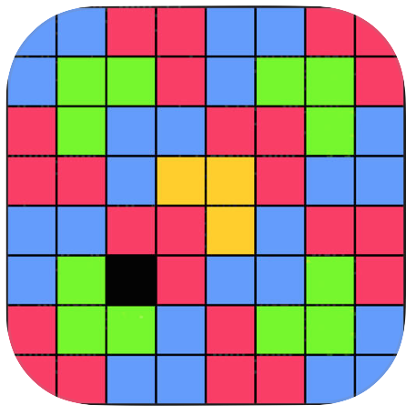
Math Fun Facts
A mobile app for the Android Platform
Built By:
Ali Elabridi
Anant Jaitha
Aidan Cheng
Anders Chaplin

Slide 2
Motivation
Bring Math Fun Facts to the Android Platform and Android users
Create an easy, intuitive, and friendly user experience
Improve upon the functionality seen in the Math Fun Facts iOS App
Address user needs (dually faceted):
Client back-end management
Front-end user interface

Slide 3
Overview: Presentation Perspectives
As A User
As A Client
As A Developer

Slide 4
As a User
As A User
As A Client
As A Developer

Slide 5
Functionality
Randomized math fun fact content generation
Filter- and select-by-difficulty
Filter- and select-by-subject
Math fun fact search-by-name feature
Choose and save favorite math fun facts
As A User
As A Client
As A Developer

Slide 6
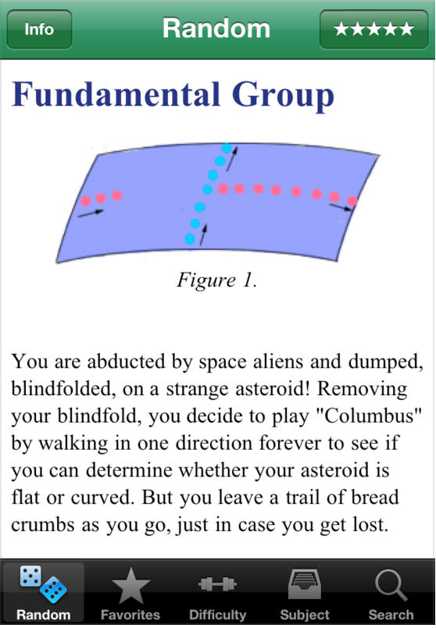
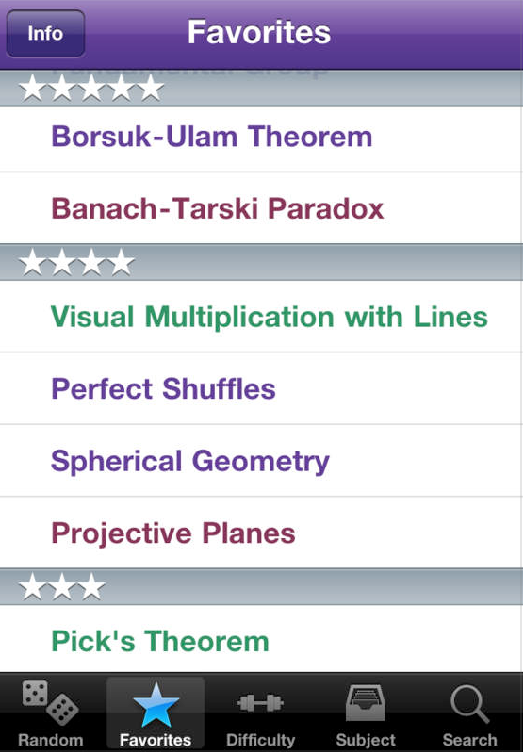
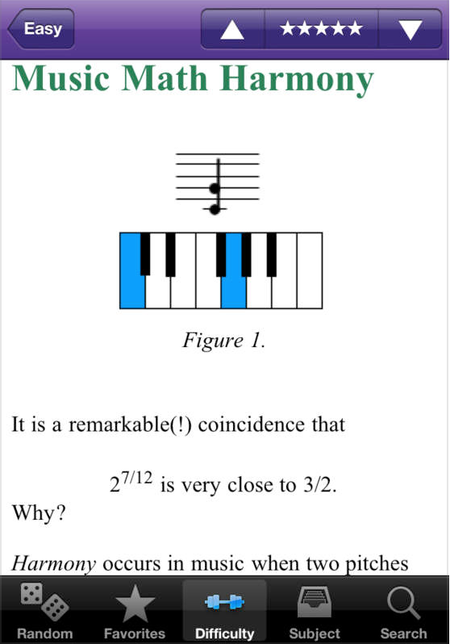
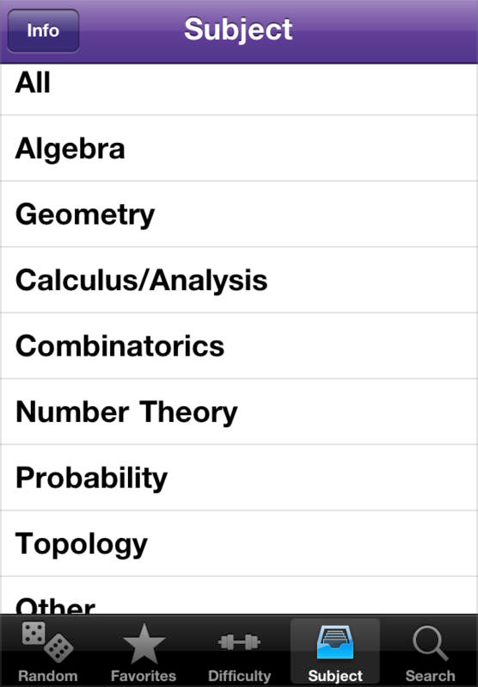
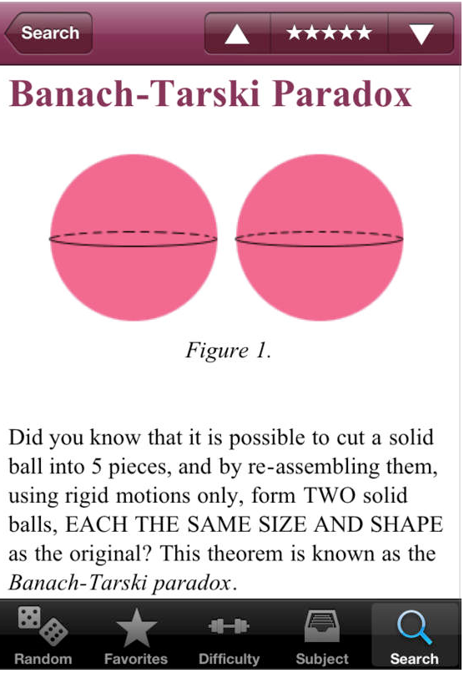
At a Glance: The Initial iOS Version
As A User
As A Client
As A Developer

Slide 7
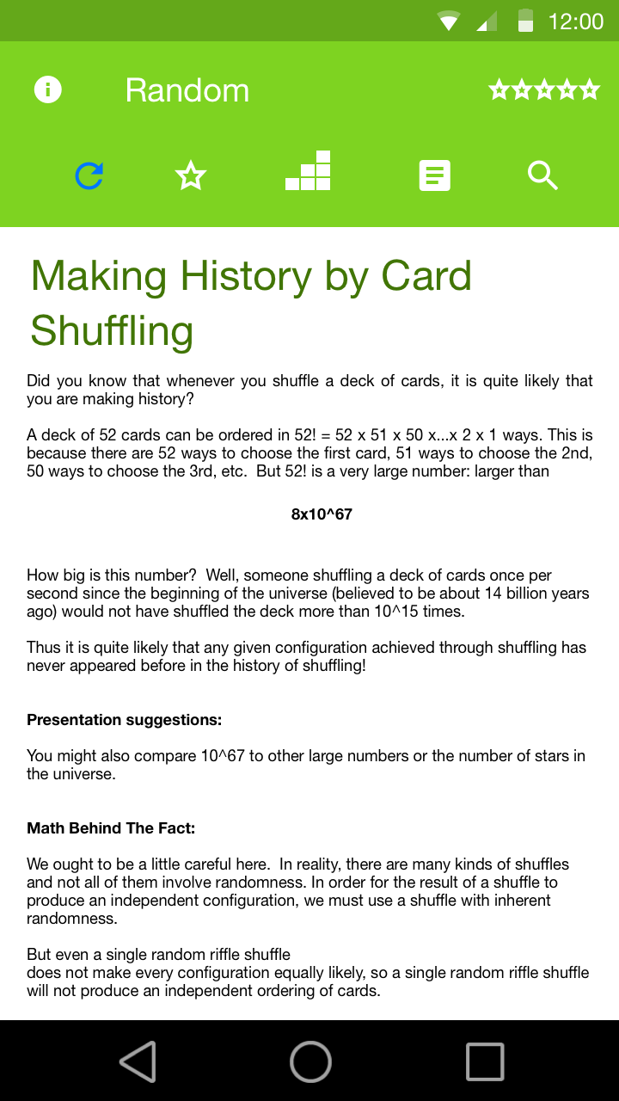
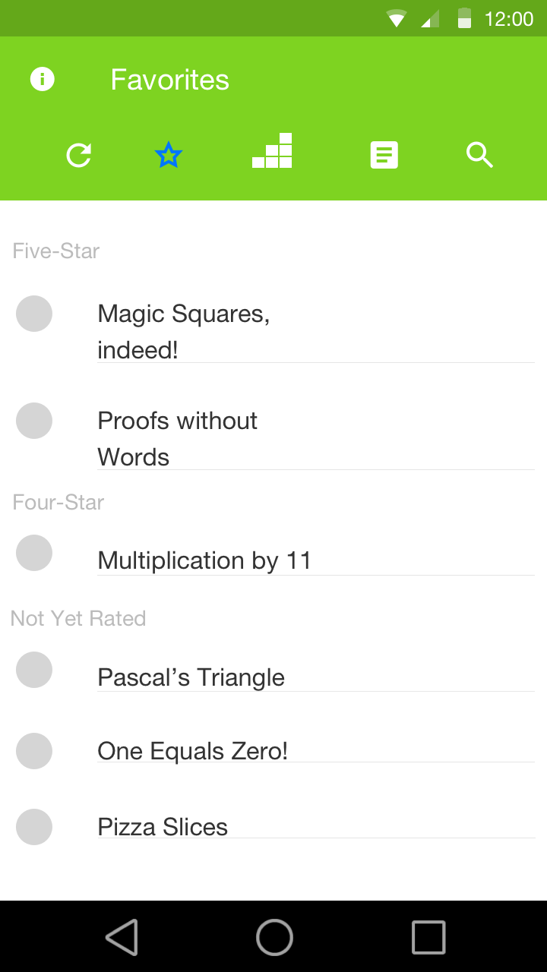
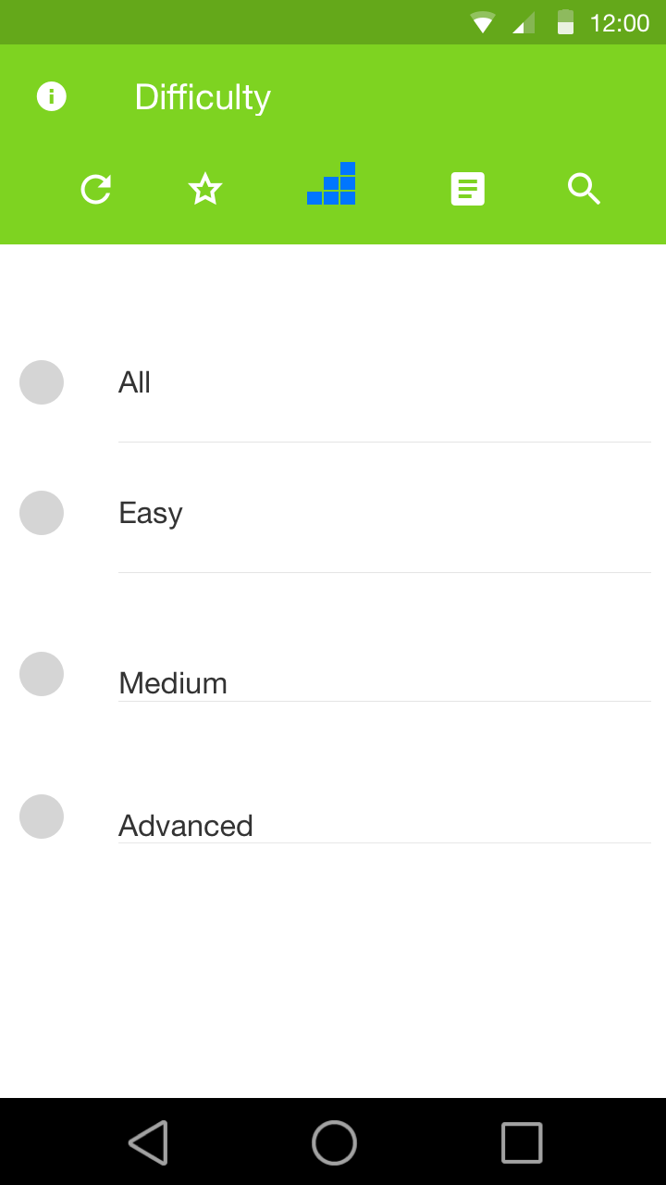
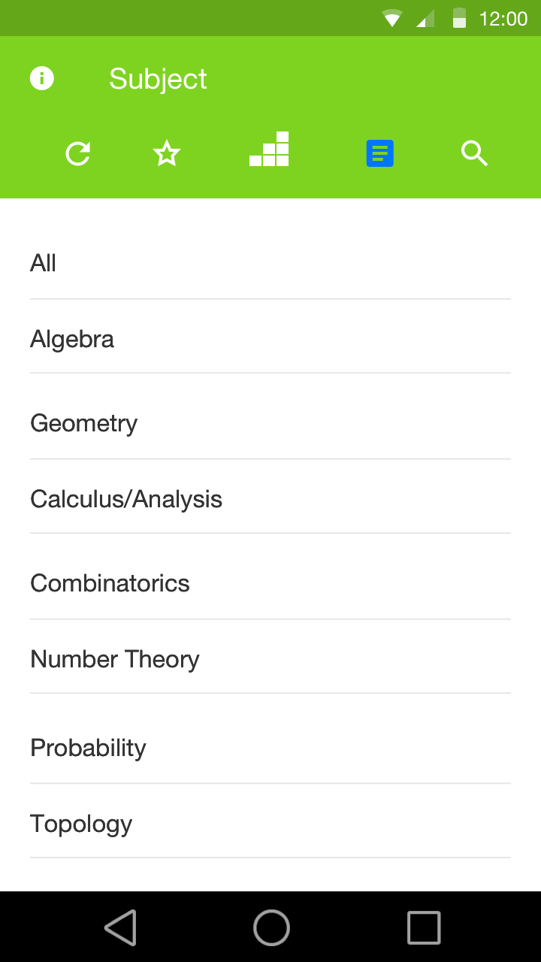
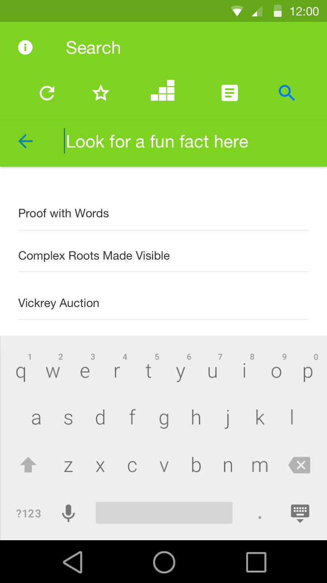
Math Fun Facts: Reimagined for Android
As A User
As A Client
As A Developer

Slide 8
Demo
As A User
As A Client
As A Developer

Slide 9
As an Admin (our client)
As A User
As A Client
As A Developer

Slide 10


Managing the Math Fun Facts App
Math Fun Facts
New Fact
As A User
As A Client
As A Developer

Slide 11
As a Developer
As A User
As A Client
As A Developer

Slide 12
Challenges
Creating user friendly UI/UX
Reading and handling math fun fact files
Integrating back-end with UI elements
Working on a new platform
Code sharing and version control
As A User
As A Client
As A Developer

Slide 13
Backend Architecture
All files are stored locally
Persistent data storage such as rating stored using JSON
Files are classified using their metadata
Files are parsed oncreate
Read rating oncreate after parsing from JSON file
Use of different comparators to filter and sort data
As A User
As A Client
As A Developer

Slide 14
Flow Diagram
As A User
As A Client
As A Developer

Slide 15
Code Walk-Through
As A User
As A Client
As A Developer

Slide 16


Moving Forward: Wrap-up
Fix edge-case bugs
Launch the App!
Pass on the APK to the client along with management instructions
As A User
As A Client
As A Developer

Slide 17

Moving Forward: Future Work
Free and Paid versions
Read and Unread Fun Facts
Cool Ways to Randomize Fun Facts
As A User
As A Client
As A Developer

